Slide 1

TRAFFIC DATA ANALYSIS
Anomalies detection:
low-rank + sparse model

Slide 2
Data and Goal
The aim of this project is to analyze Traffic flows in the Abilene Internet2 network and in particular the detection of anomalies injected during the path.
Typically, when we observed the data in the backbone of an internet network, we can always split it in two components:
the nominal traffic data, generated by user flows.
the anomalous part, which are more interested to detect, such as hijacking activities, spams, etc.
The nominal component is typical low-rank, due to the topology of the network that induced correlation. While the second component is sparse along space and time, because not all the flows contains spams.

Slide 3
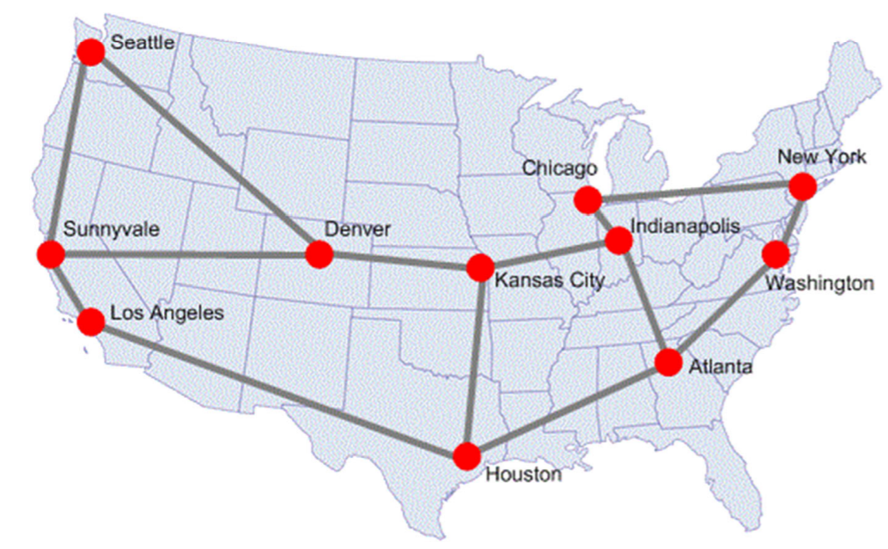
The data are based on measurements of origin-destination flows taken continuously over a seven-day period, starting December 22, 2003.
These data represent aggregate flow volumes for 12x24x7 = 2016 consecutive 5-minutes time intervals over the week, across 11x11 = 121 origin-destination pairs (including self-loops) in the 11 nodes network (where nodes represent points-of-presence).
They use the following four letters' abbreviations: Atlanta (atla), Chicago (chin), Denver (dnvr), Houston (hstn), Indianapolis (ipls), Kansas City (kscy), Los Angeles (losa), New York (nycm), Sunnyvale (snva), Seattle (sttl) and Washington D.C. (wash)

Slide 4
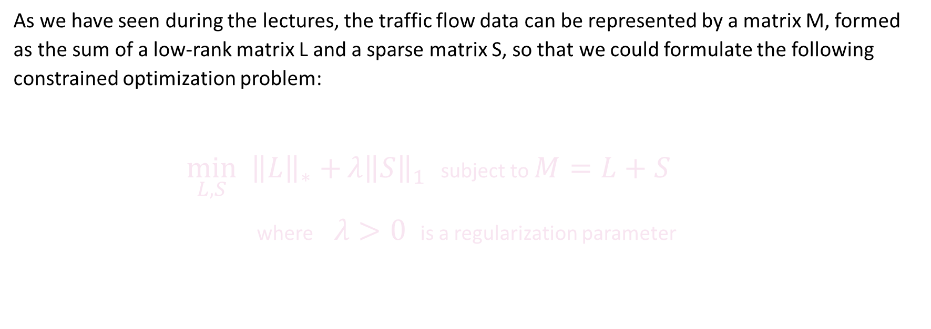
Theory : Principal Component Pursuit
As we have seen during the lectures, the traffic flow data can be represented by a matrix M, formed as the sum of a low-rank matrix L and a sparse matrix S, so that we could formulate the following constrained optimization problem:
$\min_{L,S}{{\left\|L\right\|}_{∗}+}{λ\left\|S\right\|}_{1}$ subject to $M=L+S$
where$λ>0$is a regularization parameter

Slide 5







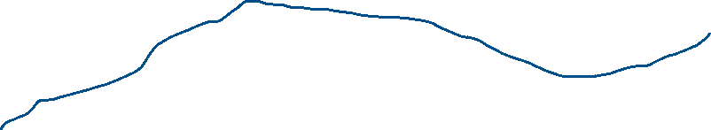



Theory : Our specific case
In traffic data analysis the mechanism that allows flows from Origin-Destination (OD) is called routing: it consisted in operations that find a path between an OD in a network composed by several links and nodes (Routers).
R
R
R

Slide 6



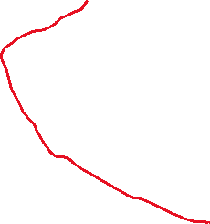
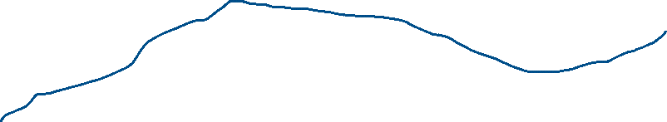




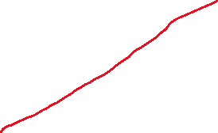

Theory : Our specific case
In traffic data analysis the mechanism that allows flows from Origin-Destination (OD) is called routing: it consisted in operations that find a path between an OD in a network composed by several links and nodes (Routers).
R
R
R

Slide 7
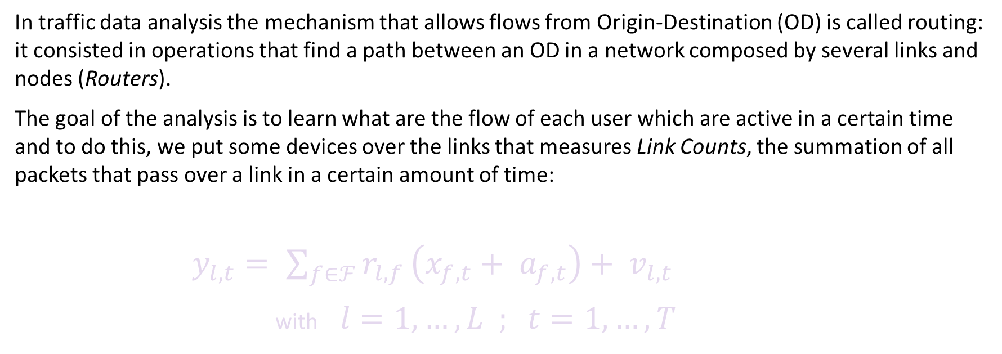
Theory : Our specific case
In traffic data analysis the mechanism that allows flows from Origin-Destination (OD) is called routing: it consisted in operations that find a path between an OD in a network composed by several links and nodes (Routers).
The goal of the analysis is to learn what are the flow of each user which are active in a certain time and to do this, we put some devices over the links that measures Link Counts, the summation of all packets that pass over a link in a certain amount of time:
$y_{l,t}= \sum_{f∈ℱ}{r_{l,f}}\left(x_{f,t}+ a_{f,t}\right)+ v_{l,t}$
with$l=1,…,L ; t=1,…,T$

Slide 8

Theory : Our specific case
In traffic data analysis the mechanism that allows flows from Origin-Destination (OD) is called routing: it consisted in operations that find a path between an OD in a network composed by several links and nodes (Routers).
The goal of the analysis is to learn what are the flow of each user which are active in a certain time and to do this, we put some devices over the links that measures Link Counts, the summation of all packets that pass over a link in a certain amount of time:
$y_{l,t}= \sum_{f∈ℱ}{r_{l,f}}\left(x_{f,t}+ a_{f,t}\right)+ v_{l,t}$
with$l=1,…,L ; t=1,…,T$
number of packets over link l
at time t

Slide 9

Theory : Our specific case
In traffic data analysis the mechanism that allows flows from Origin-Destination (OD) is called routing: it consisted in operations that find a path between an OD in a network composed by several links and nodes (Routers).
The goal of the analysis is to learn what are the flow of each user which are active in a certain time and to do this, we put some devices over the links that measures Link Counts, the summation of all packets that pass over a link in a certain amount of time:
$y_{l,t}= \sum_{f∈ℱ}{r_{l,f}}\left(x_{f,t}+ a_{f,t}\right)+ v_{l,t}$
with$l=1,…,L ; t=1,…,T$
F is the set of active flows

Slide 10

Theory : Our specific case
In traffic data analysis the mechanism that allows flows from Origin-Destination (OD) is called routing: it consisted in operations that find a path between an OD in a network composed by several links and nodes (Routers).
The goal of the analysis is to learn what are the flow of each user which are active in a certain time and to do this, we put some devices over the links that measures Link Counts, the summation of all packets that pass over a link in a certain amount of time:
$y_{l,t}= \sum_{f∈ℱ}{r_{l,f}}\left(x_{f,t}+ a_{f,t}\right)+ v_{l,t}$
with$l=1,…,L ; t=1,…,T$
Routing coefficient
( = 1 if flow f passes through link l )

Slide 11

Theory : Our specific case
In traffic data analysis the mechanism that allows flows from Origin-Destination (OD) is called routing: it consisted in operations that find a path between an OD in a network composed by several links and nodes (Routers).
The goal of the analysis is to learn what are the flow of each user which are active in a certain time and to do this, we put some devices over the links that measures Link Counts, the summation of all packets that pass over a link in a certain amount of time:
$y_{l,t}= \sum_{f∈ℱ}{r_{l,f}}\left(x_{f,t}+ a_{f,t}\right)+ v_{l,t}$
with$l=1,…,L ; t=1,…,T$
Flow generated by user f at time t

Slide 12

Theory : Our specific case
In traffic data analysis the mechanism that allows flows from Origin-Destination (OD) is called routing: it consisted in operations that find a path between an OD in a network composed by several links and nodes (Routers).
The goal of the analysis is to learn what are the flow of each user which are active in a certain time and to do this, we put some devices over the links that measures Link Counts, the summation of all packets that pass over a link in a certain amount of time:
$y_{l,t}= \sum_{f∈ℱ}{r_{l,f}}\left(x_{f,t}+ a_{f,t}\right)+ v_{l,t}$
with$l=1,…,L ; t=1,…,T$
Anomaly injected by user f at time t

Slide 13
Theory : Our specific case
In traffic data analysis the mechanism that allows flows from Origin-Destination (OD) is called routing: it consisted in operations that find a path between an OD in a network composed by several links and nodes (Routers).
The goal of the analysis is to learn what are the flow of each user which are active in a certain time and to do this, we put some devices over the links that measures Link Counts, the summation of all packets that pass over a link in a certain amount of time:
$y_{l,t}= \sum_{f∈ℱ}{r_{l,f}}\left(x_{f,t}+ a_{f,t}\right)+ v_{l,t}$
with$l=1,…,L ; t=1,…,T$
Measurement noise

Slide 14

Theory : Our specific case
In traffic data analysis the mechanism that allows flows from Origin-Destination (OD) is called routing: it consisted in operations that find a path between an OD in a network composed by several links and nodes (Routers).
The goal of the analysis is to learn what are the flow of each user which are active in a certain time and to do this, we put some devices over the links that measures Link Counts, the summation of all packets that pass over a link in a certain amount of time:
$y_{l,t}= \sum_{f∈ℱ}{r_{l,f}}\left(x_{f,t}+ a_{f,t}\right)+ v_{l,t}$
with$l=1,…,L ; t=1,…,T$
$$Y=R\left(X+A\right)+V$$

Slide 15
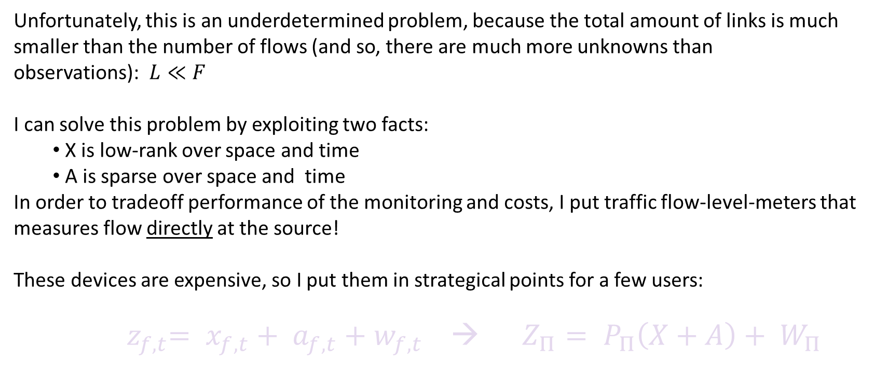
Theory : Problem & Solution
Unfortunately, this is an underdetermined problem, because the total amount of links is much smaller than the number of flows (and so, there are much more unknowns than observations): $L≪F$
I can solve this problem by exploiting two facts:
X is low-rank over space and time
A is sparse over space and time
In order to tradeoff performance of the monitoring and costs, I put traffic flow-level-meters that measures flow directly at the source!
These devices are expensive, so I put them in strategical points for a few users:
${ z}_{f,t}= x_{f,t}+ a_{f,t}+w_{f,t}$ → $Z_{Π}= P_{Π}\left(X+A\right)+ W_{Π}$
$P_{Π}$ is the sampling operator on the set of flows $Π$ , $W_{Π}$ is the noise measurements

Slide 16
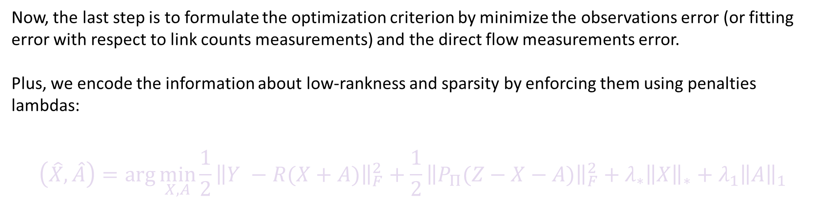
Theory : Problem Formulation
Now, the last step is to formulate the optimization criterion by minimize the observations error (or fitting error with respect to link counts measurements) and the direct flow measurements error.
Plus, we encode the information about low-rankness and sparsity by enforcing them using penalties lambdas:
$$\left(\hat{X},\hat{A}\right)=\arg{\min_{X,A}{\frac{1}{2}}}{\left\|Y −R(X+A)\right\|}_{F}^{2}+\frac{1}{2}{\left\|P_{Π}(Z−X−A)\right\|}_{F}^{2}+λ_{∗}{\left\|X\right\|}_{∗}+λ_{1}{\left\|A\right\|}_{1}$$
This is a convex problem, because the norm squared is convex and there are linear operations inside, it's a sum of two convex functions, and we have two proper norms with positive coefficients, hence the whole objective function is convex.

Slide 17
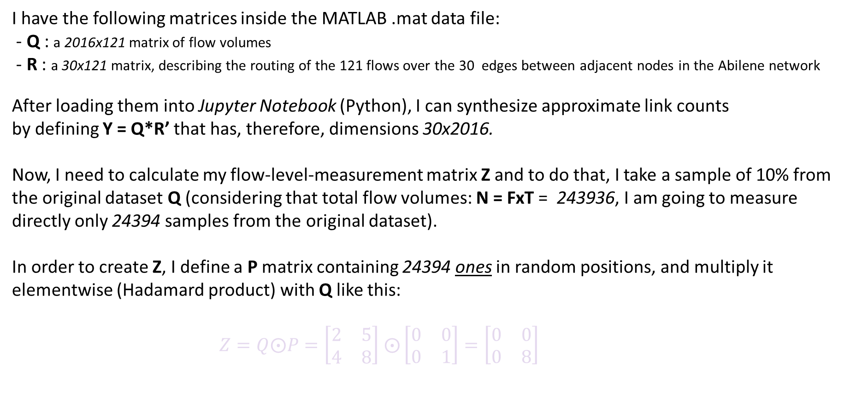
Practice : Prepare dataset
I have the following matrices inside the MATLAB .mat data file:
- Q : a 2016x121 matrix of flow volumes
- R : a 30x121 matrix, describing the routing of the 121 flows over the 30 edges between adjacent nodes in the Abilene network
After loading them into Jupyter Notebook (Python), I can synthesize approximate link counts
by defining Y = Q*R’ that has, therefore, dimensions 30x2016.
Now, I need to calculate my flow-level-measurement matrix Z and to do that, I take a sample of 10% from the original dataset Q (considering that total flow volumes: N = FxT = 243936, I am going to measure directly only 24394 samples from the original dataset).
In order to create Z, I define a P matrix containing 24394 ones in random positions, and multiply it elementwise (Hadamard product) with Q like this:
$Z=Q⨀P=\left[\begin{matrix}2 & 5 \\ 4 & 8\end{matrix}\right]$ $⨀\left[\begin{matrix}0 & 0 \\ 0 & 1\end{matrix}\right]=\left[\begin{matrix}0 & 0 \\ 0 & 8\end{matrix}\right]$

Slide 18
Practice : Optimization with CVXPY
To formulate and solve the convex optimization problem I am going to use the CVXPY package, alternative version of CVX for Python. Instead of using the formulation derived from the theory, I put some constraints:
First of all, I defined the output variables I want:
A,X = cvx.Variable((F,T)) → G = X+A
I put the terms in the Frobenious form as constraints:
constraints = [Z==cvx.multiply(P,G),Y == R@G, A >= 0, X >= 0]
I define the objective function:
objective = cvx.Minimize(cvx.norm(X, 'nuc') + (lamb * cvx.norm1(A)))
Finally, I define the problem and the solver:
problem = cvx.Problem(objective, constraints)
problem.solve(solver=cvx.SCS)
As a loss function to calculate the error I use Mean Squared Error:
MSE = cvx.sum_squares(Q - G)/cvx.sum_squares(Q)

Slide 19

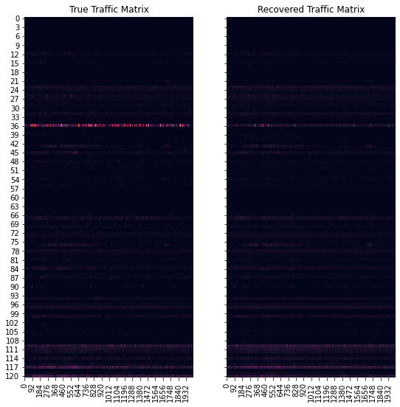
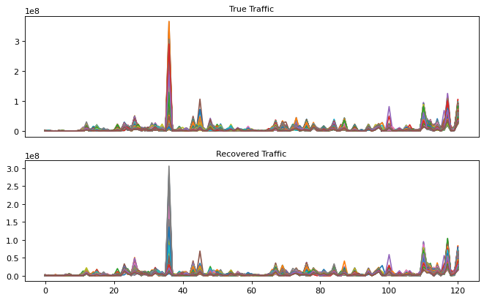
Practice : 1st try
Using the base model defined on CVXPY, even though it reached the optimal solution,
the program has run for over 2 hour and half!
Here’s some plots and matrices to compare the recovered traffic with the original one:

Slide 20
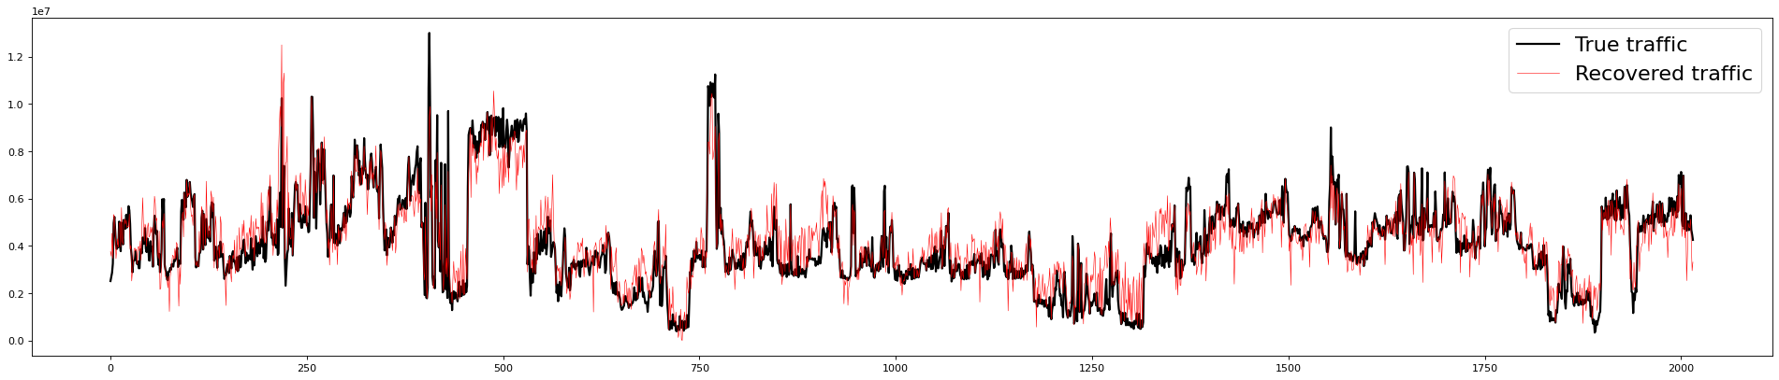
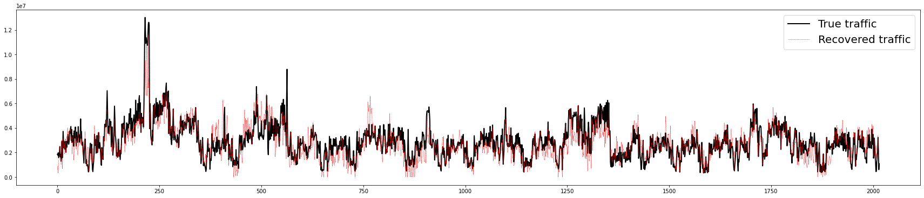


Practice : 1st try
Using the base model defined on CVXPY, even though it reached the optimal solution,
the program has run for over 2 hour and half!
Here’s some plots and matrices to compare the recovered traffic with the original one:
DENVER-LOS ANGELES
DENVER-SUNNYVALE

Slide 21
Practice : 2nd try
To speed up and make a better optimization with CVXPY, I need to decrease the observed slots in terms of time instants. To do this I re-defined some functions just used in an external .py file:
set_data : this function allows me to choose the shape I want to consider from the Ground-Truth matrix Q and the Routing matrix R.
preprocess : this function allows me to create the LinkCounts matrix Y and the Sampling matrix P to get the Flow-level measurement matrix Z.
PCP : this function perform the Principal Component Pursuit taking as arguments the shape of interest for the components, matrices and minimum & maximum for penalty lambda (default = 0.1 – 0.5)
THIS TIME LAMBDA IS SET AS A PARAMETER THAT CHANGES AT EVERY ITERATION and ITS CHOICE IS BASED ON SINGULAR MSE.
show_plots : it simply prints 2 subplots to compare true traffic and the recovered one

Slide 22
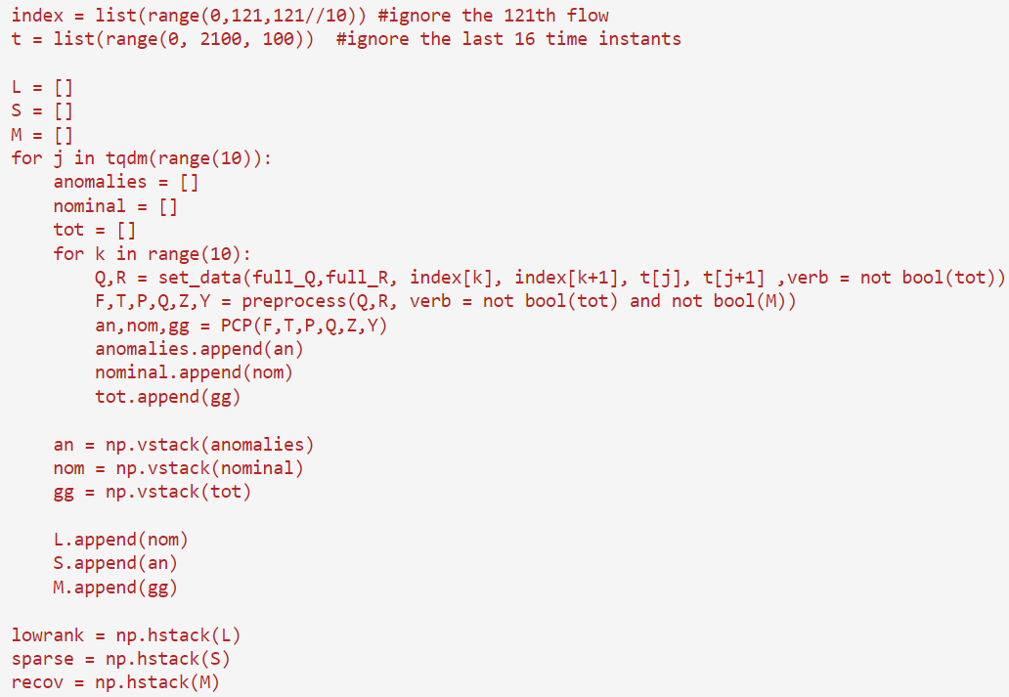
Practice : 2nd try
Through this “funct.py” I create a method to build a 2-for-loops with a lower complexity than the previous code;
indeed, CVXPY doesn’t support parallelization, but using the parameter Lambda I can create small problems that can be solved faster:
It took about 90 minutes to work on the entire dataset (split in 10 parts), and the results are pretty good (on the notebook you can run an example that runs for 1 minute).

Slide 23
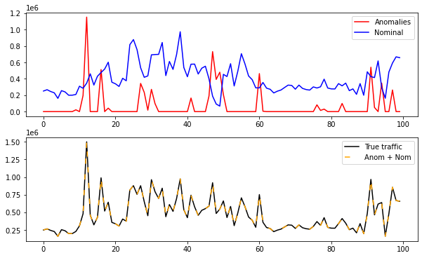


Practice : 2nd try
These are the results of the partial test with 50 flow and 100-time instants:

Slide 24
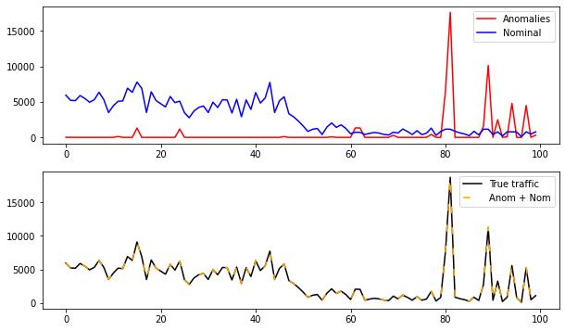

Practice : 2nd try
These are the results of the partial test with 50 flow and 100-time instants:

Slide 25
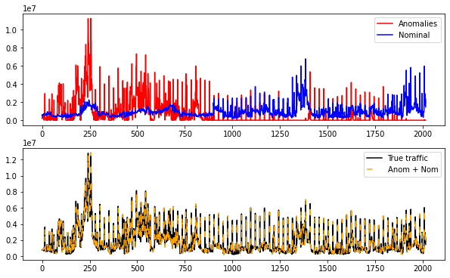


Practice : 2nd try
These are the overall results:

Slide 26
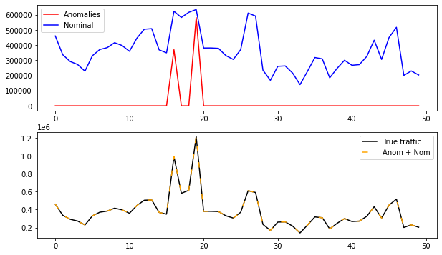



Practice : 2nd try
These are the overall results:

Slide 27
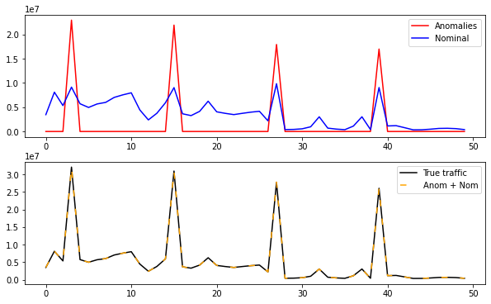


Practice : 2nd try
These are the overall results:

Slide 28
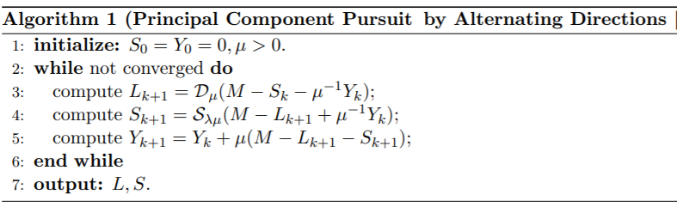
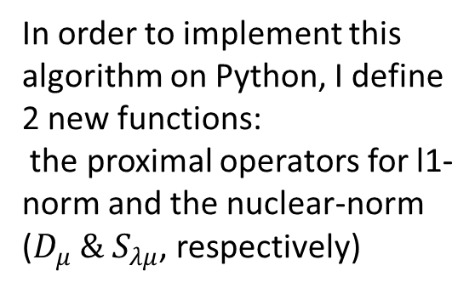
Practice : Last try
As a last tentative to increase accuracy and speed, I put aside the CVX tool, and by taking full advantage of the theory I am going to apply the Alternating Direction Method of Multipliers (ADMM) to implement a Robust Principal Component Analysis directly on the Q matrix.
The idea behind this method is a proximal gradient algorithm with lower complexity which can solve the problem by alternating the optimization between low-rank component and sparse component:
In order to implement this algorithm on Python, I define 2 new functions:
the proximal operators for l1-norm and the nuclear-norm
($D_{μ} \&{ S}_{λμ}$, respectively)
https://arxiv.org/pdf/0912.3599.pdf (page 29)

Slide 29
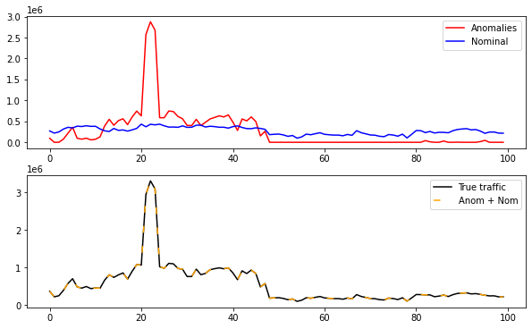
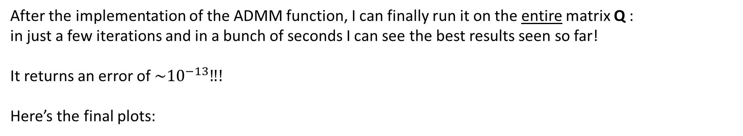
Practice : Last try
After the implementation of the ADMM function, I can finally run it on the entire matrix Q :
in just a few iterations and in a bunch of seconds I can see the best results seen so far!
It returns an error of ${\sim 10}^{−13}‼!$
Here’s the final plots:

Slide 30
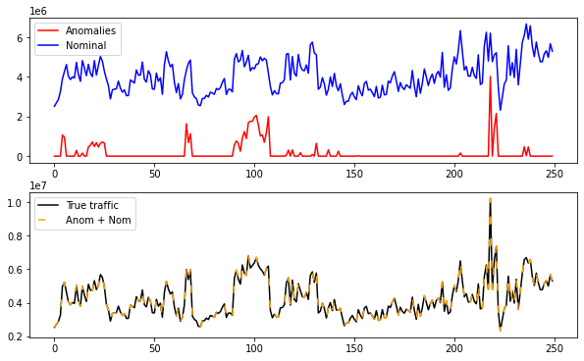
Practice : Last try
After the implementation of the ADMM function, I can finally run it on the entire matrix Q :
in just a few iterations and in a bunch of seconds I can see the best results seen so far!
It returns an error of ${\sim 10}^{−13}‼!$
Here’s the final plots:

Slide 31
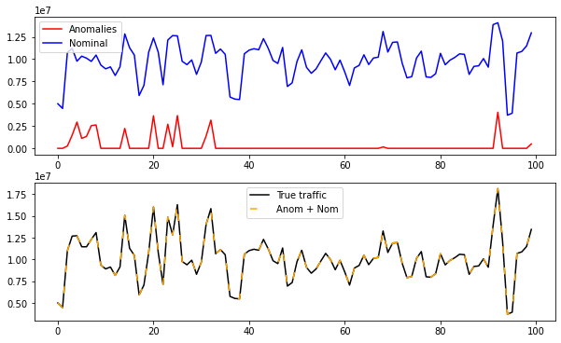
Practice : Last try
After the implementation of the ADMM function, I can finally run it on the entire matrix Q :
in just a few iterations and in a bunch of seconds I can see the best results seen so far!
It returns an error of ${\sim 10}^{−13}‼!$
Here’s the final plots:

Slide 32
References
Structural analysis of network traffic flows
(2004, A. Lakhina, K. Papgiannaki, C. Crovella, M. Diot, E. Kolaczyk, and N. Taft)
Vessel Traffic flow separation-Prediction using low-rank and sparse decomposition (Oct 2017 by Ryan Wen Liu, Jinwei Chen et al.)
Robust Principal Component Analysis
(Dec 2009, Candes E., Xiaodong L. and Wright J.)
SPBD Slides - Mathematical Optimization: Theory and Applications to DS
(Sergio Barbarossa and Paolo Di Lorenzo)

Slide 33
THANKS FOR THE ATTENTION!
(the whole project is public and can be downloaded at the following link: https://github.com/TomBombadil95/SPBD)

